Slide 1
STUMBLING ON HAPPINESS By Daniel Gilbert
Total: 22 Slides

Slide 2
Contents
Book and the Author – Slide 3
Foreword – Slide 4
Part I : Prospection - Slides 5-6
Part II: Subjectivity – Slides 7-9
Part III: Realism – Slides 10-12
Part IV: Presentism – Slides 13-15
Part V: Rationalisation – Slides 16-18
Part VI: Corrigibility – Slides 19-21

Slide 3
Book And The Author
Year of Publication: 2007
Publisher: Vintage Books, US
Author: Daniel Gilbert is a Psychology Professor at Harvard University
He has won numerous awards for his work in this field.

Slide 4
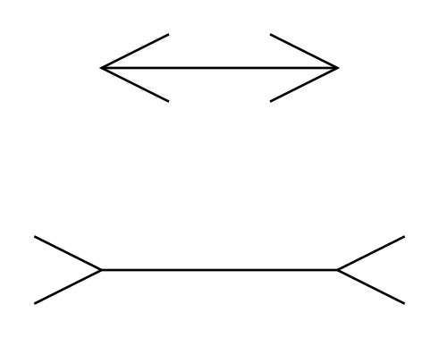
Foreword
Plan for future happiness
Optical illusions and errors
Findings from various fields.

Slide 5
PART I Prospection - The act of looking forward in time or considering the future

Slide 6
Journey To Elsewhen
“The human being is the only animal that thinks about the future”
Two types of future thinking:
Immediate, personal, local
Imagining the future, planning for later
Every one out of eight. Why?
Pleasant
Reducing the impact of unpleasant events
Motivate through fear and anxiety
Control through knowledge – need for control

Slide 7
PART II Subjectivity - The fact that experience is unobservable to everyone but the person having it

Slide 8
The View From In Here
Happiness is a subjective feeling
Yellow and the Alien
Can’t rigidly define happiness
Various experiences give rise to happiness
The problem of comparison
Inter-personal
Inter-happiness
Weakness of memory – synopses
Colour swatches

Slide 9
Outside Looking In
Misinterpretation of feelings – causal attribution
Bridge study
Awareness, Experience, and Emotions
Alexithymia
Measuring happiness:
Imperfect, but better than nothing
Honest, real-time, self-report
Law of large numbers
Problem: Often flawed imagination of future happiness

Slide 10
PART III Realism - The belief that things are in reality as they appear to be in the mind

Slide 11
In The Blind Spot Of The Mind’s Eye
Filling in:
Memory – Red Car Study
Perception – Visual Blind Spot
Imagination – Spaghetti
Our own details
Adolf Fischer and George Eastman
Wife and the Party
Lack of conscious awareness

Slide 12
The Hound Of Silence
Sherlock Holmes
Emphasizing presences vs. Ignoring Absences
The ‘T’ study
34 times vs. Not even once
Imagining future – same error
Death of a son
Football team winning
Near vs. Far
Space
Time

Slide 13
PART IV Presentism - The tendency for current experience to influence one’s views of the past and the future

Slide 14
The Future Is Now
Our present feelings affect
How we remember past
How we imagine future
Perot – presidential candidate (pg. 126)
Imagining curiosity
Geography quiz
Imagining hunger
Same areas of brain – visual, auditory
Preference of the current
Confusion between perception or imagination

Slide 15
Time Bombs
Abstract (e.g. time) in Concrete terms (space)
Habituation and Factors affecting happiness
Variety vs. No variety study
Time interval
Variety
Variety irrelevant when sufficient interval
Comparison with
The past
The possible

Slide 16
PART V Rationalization - The act of causing something to be or to seem reasonable

Slide 17
Paradise Glossed
Disambiguating objects
Context; frequency; recency
THE
CAT
Disambiguating experience
Tending towards positive
Psychological Immune System
Cooking facts, feeling positive
Both positive and credible
Standardized tests
Crime Rates

Slide 18
Immune to Reality
Not seeing future rationalization
Clever Hans, the horse
Single Juror vs. Jury
Little vs. Intense Triggers
Me or my cousin
Co-Volunteer
Inescapability Trigger
Explaining away
Positive – reduction of grief/pain
Negative – reduction of pleasure

Slide 19
PART VI Corrigibility - Ability to be corrected, reformed, or improved

Slide 20
Once Bitten
Practice and Coaching – the way to learn
Experience and emotional futures
Least like experience, the most likely memory (grocery store)
The end-affinity (movie argument)
External theories modifying
Gender
American Presidential Candidates

Slide 21
Reporting Live from Tomorrow
Gene propagation – beliefs (false) propagation
Imagination’s shortcomings:
Fill in, leave out
Present colouring the future
Not considering rationalization
Solution - Surrogation
The surrogation studies
Why we don’t accept it

Slide 22
Thank You

